Slide 1
Dominate your enterprise and your software delivery using XebiaLabs and AWS
September 13, 2018

Slide 2
Elite Performers Are More Agile
46x
2,555x
more frequent deployments
faster lead times from commit to deploy
Source: DORA: Accelerate: State of DevOps 2018: Strategies for a New Economy: https://devops-research.com/2018/08/announcing-accelerate-state-of-devops-2018/
Notes:
Elite performers lead time, reporting that the time from committing code to having that code successfully deployed in production, conservative upper end estimate of “less than one hour

Slide 3
Elite Performers Are More Reliable
7x
2,604x
lower change failure rate
(changes are 1/7 as likely to fail)
time to recover from incidents
Source: DORA: Accelerate: State of DevOps 2018: Strategies for a New Economy: https://devops-research.com/2018/08/announcing-accelerate-state-of-devops-2018/
Notes:
Elite performers reported a change failure rate between zero and 15 percent,

Slide 4
Elite Performers Do Cool Stuff
25%
20%
less time spent on manual work
more time spent on new work
Source: DORA: Accelerate: State of DevOps 2018: Strategies for a New Economy: https://devops-research.com/2018/08/announcing-accelerate-state-of-devops-2018/
Notes:
Elites - only 5% of deployments is manual work, only spend 1/3 the time on customer support work

Slide 5
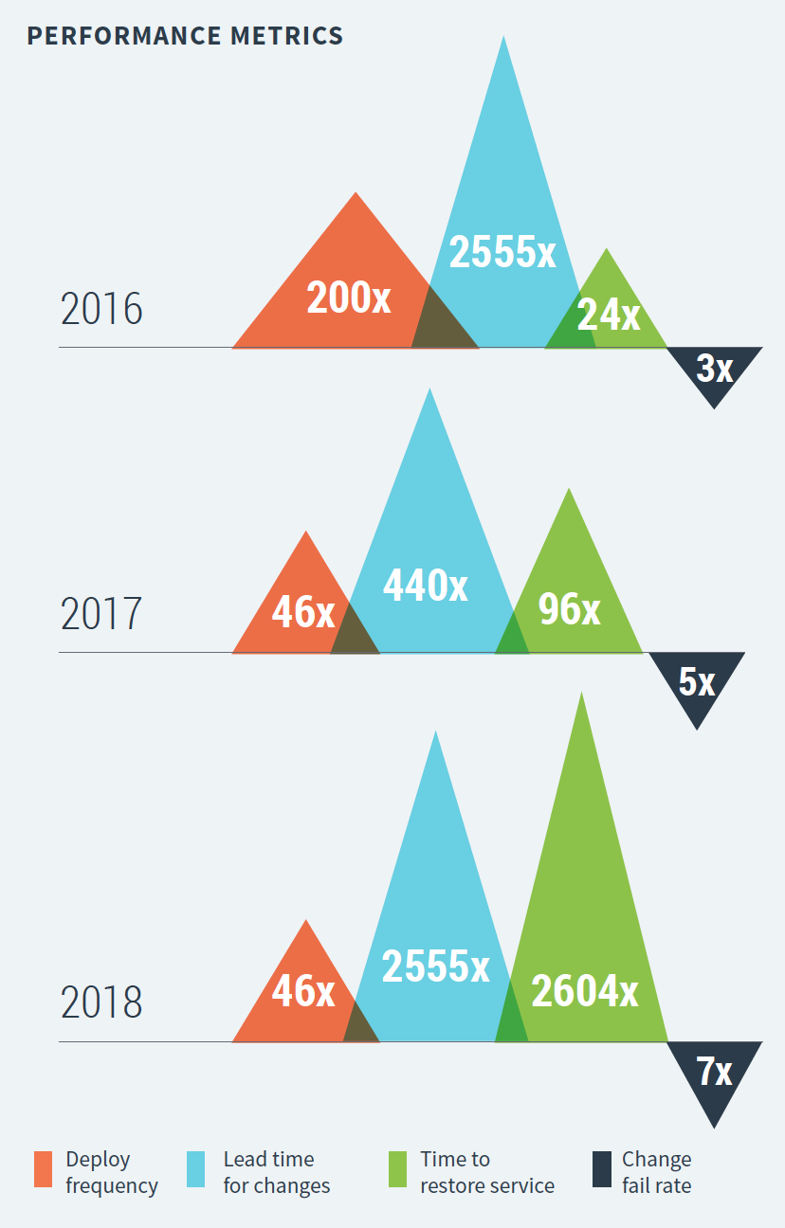
Better and Better

Slide 6
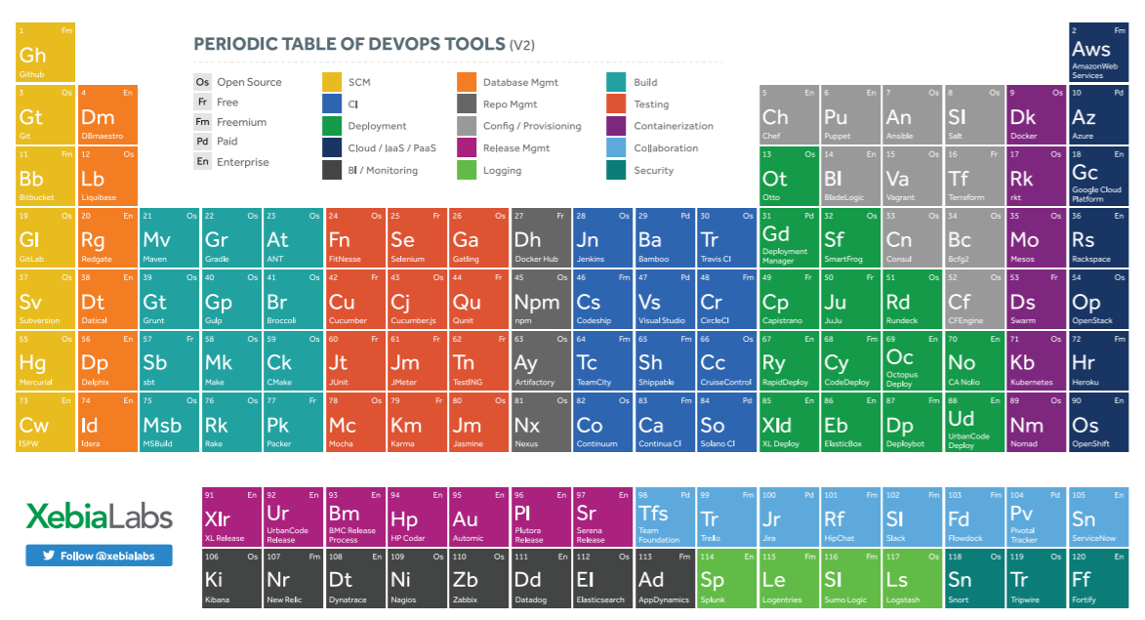
So Many Tools!
Notes:
What is minimum tool set needed in DevOps?

Slide 7
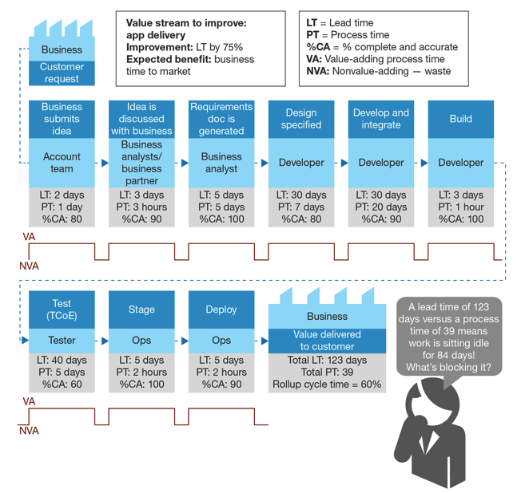
Organizational Challenges
Wait time Typically > Task Time
Root Causes
Role Silos
Sharing Resources Across Projects
Lack of a “Product Team” model

Slide 8
Scaling Challenges
Departmental Success != Enterprise-wide Success
Compliance
Visibility
Maintainability
Repeatability
Technical and Non-technical Participants

Slide 9


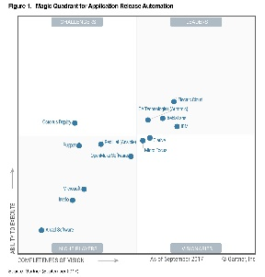

Enterprise DevOps Platform intelligence, automation and control
Learn more: www.youtube.com/xebialabs
Hundreds of Companies deliver software with XebiaLabs - faster, safer and more customer focused
Top-ranked
Continuous Delivery and DevOps pioneer, authority and technology leader
Global team in the US, Europe & APAC

Slide 10
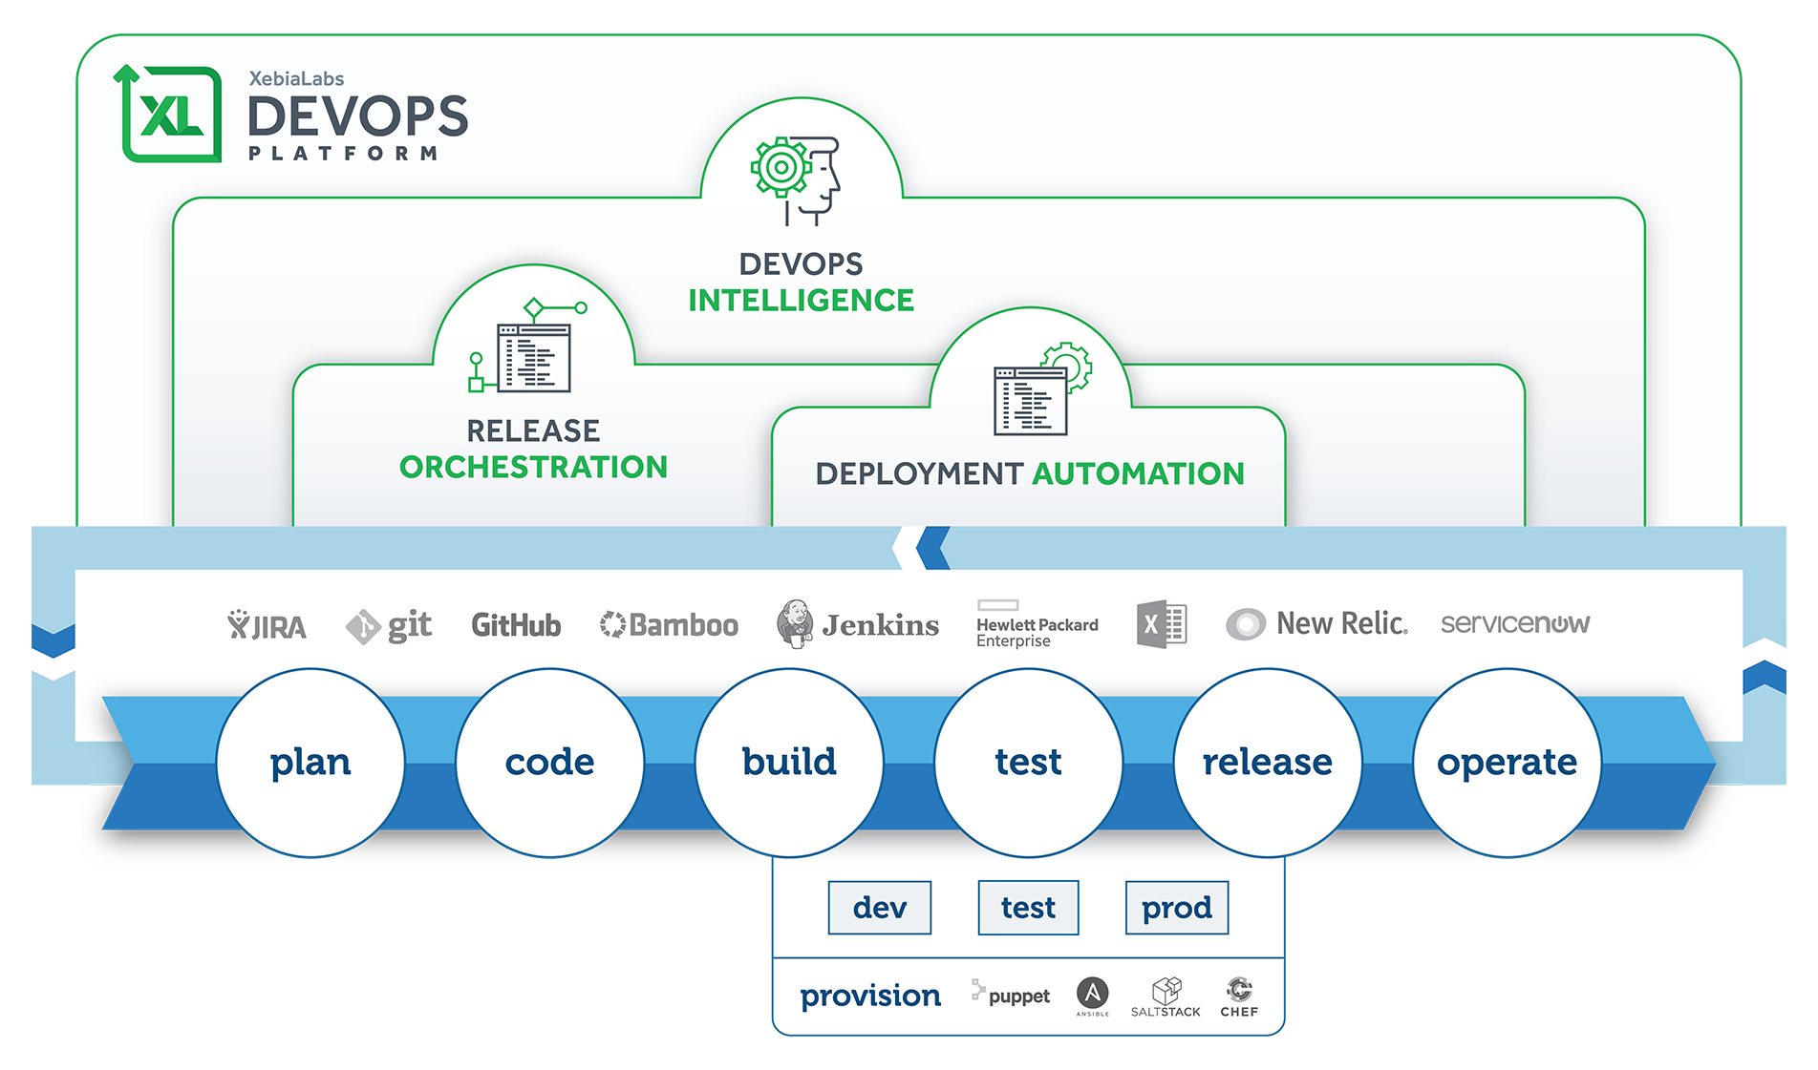
XebiaLabs Platform

Slide 11
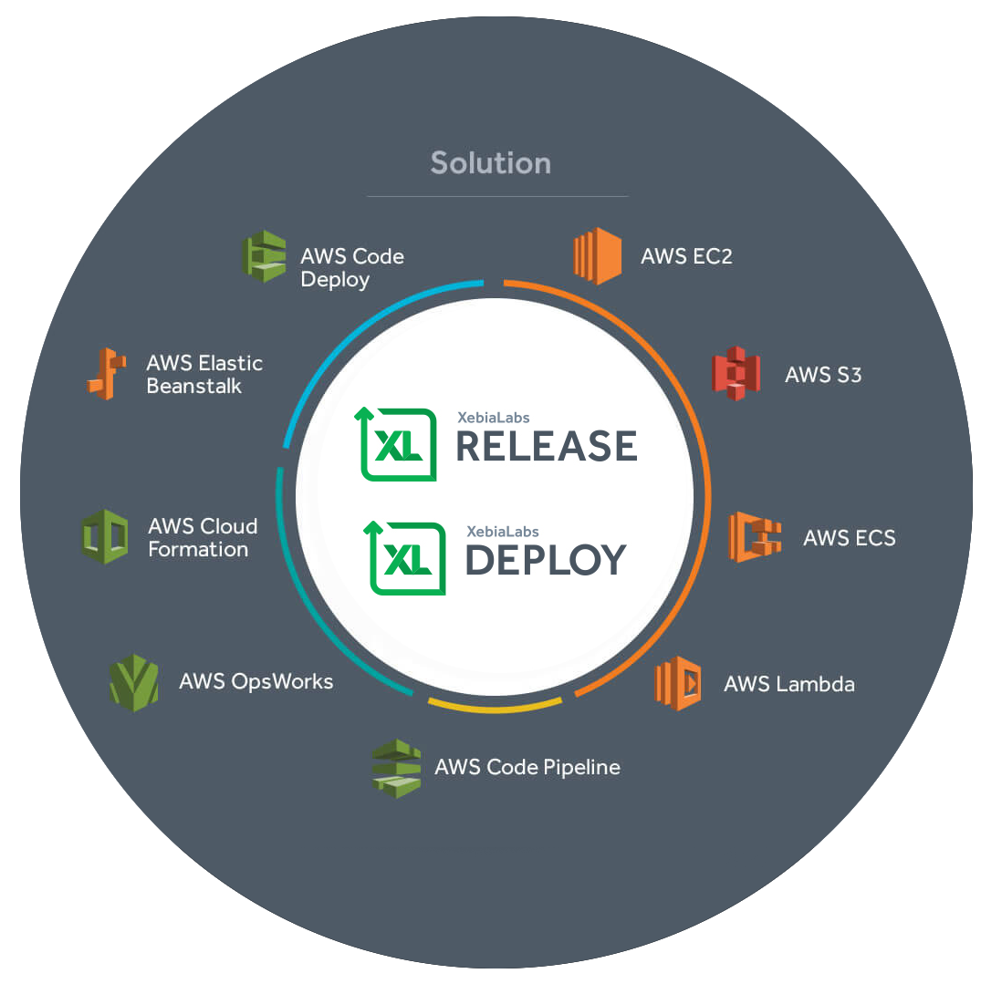
AWS DevOps Competency Partner

Slide 12


AWS SUPPORT IN PLATFORM 8.2
XL Deploy AWS plugin
Enables XL Deploy to work with AWS Services such as:
Elastic Compute Cloud (EC2)
Simple Storage Service (S3)
EC2 Container Service (ECS)
AWS Lambda functions and AWS API Gateway
Fargate
XL Deploy Tasks
Enables XL Release to orchestrate, automate and view software delivery pipelines that include AWS tasks such as:
Launch / terminate AWS EC2 and VPC instances
Deploy application to AWS cloud-based instances
Provision EC2 instances & deploy applications to them
Deploy AWS Lambda functions
Provision AWS API Gateway to invoke Lambda functions
Fargate deployments
Release
Deploy
AWS

Slide 13
